Slide 1

DEPARTMENT OF ELECTRONICS & COMUNICATION ENGINEERING
Intelligent Classroom automation with CV2-Driven IOT Solution
Batch No: A4
1. 21471A0436 Pokala Naga Krishna
2. 21471A0437 Potluri Bhulakshmi
3. 21471A0439 Sanampudi Pavan Kalyan
4. 21471A0407 Duddukuri Vachalya
5. 21471A0435 Pilli Bhavana
6. 21471A0441 Shaik Althaf Raj
Name of Guide: Dr.B.Siva NageswaraRao
Asst Prof

Slide 2
Outline of the Presentation
Introduction
Objective of the Project
Block Diagram
Components
Literature Survey
Existing Methods
Proposed Methods
Software Requirements
Partial Results
References

Slide 3
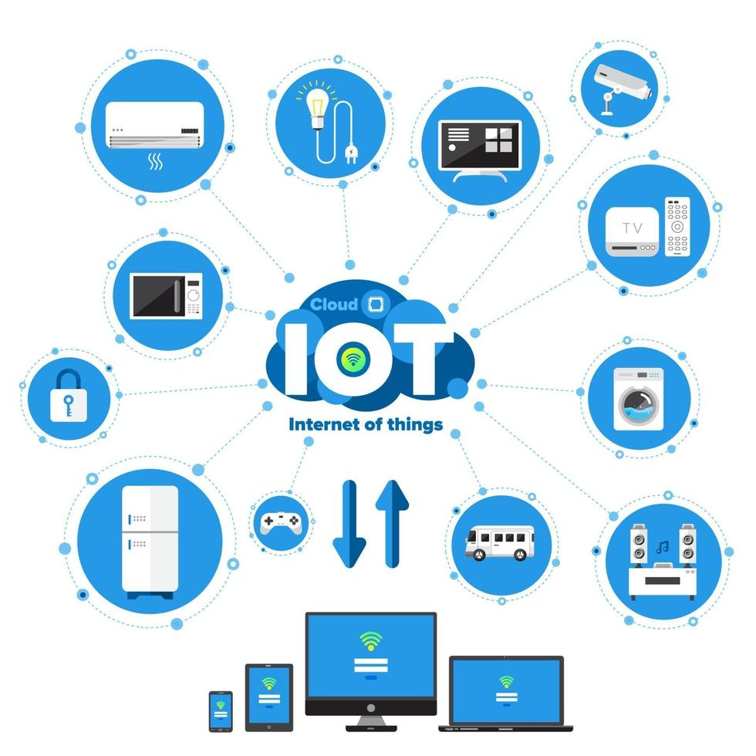
Introduction
What is an IOT ?
IoT (Internet of Things) is a dynamic innovation with a powerful impact on today’s world which can make human life simple and effortless.
The scope of this field is limitless and has emerged as a winner in various areas ranging from Medicine, Engineering, Computer Science, Space and Technology, Automobiles and so on.
The center of purpose is utilizing IoT based technology in accomplishing automation for classrooms.

Slide 4
Introduction cont..
Intelligent Classroom :
We propose an approach to control and manage electrical equipments such as fans and lights based on human presence.
Our focus is towards building a solution which could help in reducing overutilization of energy.
A camera is used for recognizing the presence of people in the classroom and for analyzing their seating position. Here a classroom is divided into two segments. Whenever a human presence is detected in a particular segment then the light and fan will be switched ON.
The reasonable objective of this paper is how to build up a smart classroom where we can automate the electrical equipments with a focus towards energy conservation

Slide 5
Objectives of the Project
Make Classroom Management Easier: Computer vision can help teachers with administrative tasks, like tracking strength of the class, giving them more time to focus on teaching and supporting students.
Offer Insights to Teachers: Computer vision can give teachers valuable insights into how their students are attending, helping them adjust their teaching methods to better meet everyone’s needs.
Support All Learners: By this ,we can make students more discipline while learning, ensuring that everyone has the opportunity to succeed in a supportive and inclusive environment.

Slide 6
benefits
1. Strength of the classroom
Count the number of students in the class by detecting their faces.
2. Classroom occupancy detection
It will calculate the percentage of class, which classroom occupied by the students.
3. Classroom automation
Iot control the electrical devices in the classroom
4. Mobile notifications
Strength, zone and occupancy are send as a notification through the telegram bot

Slide 7
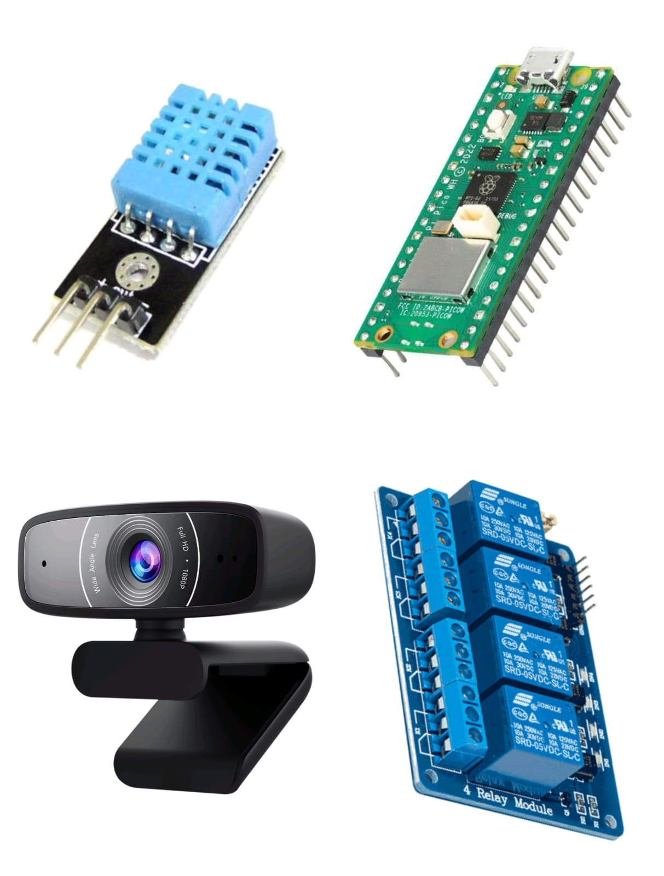

COMPONENTS :
Raspberry Pi Pico
5VDC Relay Module 4 Channel
USB Camera

Slide 8
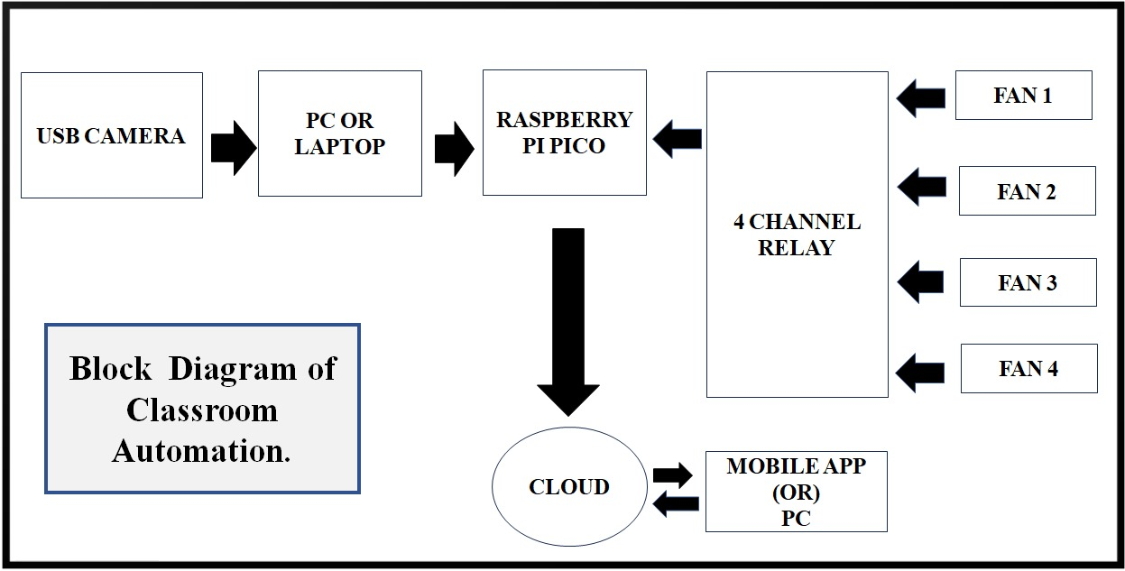
Block Diagram

Slide 9
LITERATURE SURVEY
Ref. no | Authors | Title | Journal | Observation/remarks | Applications
1. | S. S. Rao et al. | "Automated Attendance System using IoT Sensors and AI” | International Journal of Advanced Research in Computer Science | Proposed a novel attendance system using IoT sensors and AI, achieving 95% accuracy. | Education, Attendance Tracking
2. | K. Singh et al. | "Personalized Learning Platform using Machine Learning and IoT“ | International Journal of Intelligent Systems and Applications | Developed a personalized learning platform using machine learning and IoT, resulting in improved student engagement. | Education, Personalized Learning |
3. | R. K. Sharma et al. | "Real-time Feedback System using AI-powered Chatbots and IoT" | International Journal of Advanced Research in Computer Science | Designed a real-time feedback system using AI-powered chatbots and IoT, enhancing student-teacher interaction. | Education, Feedback Systems

Slide 10
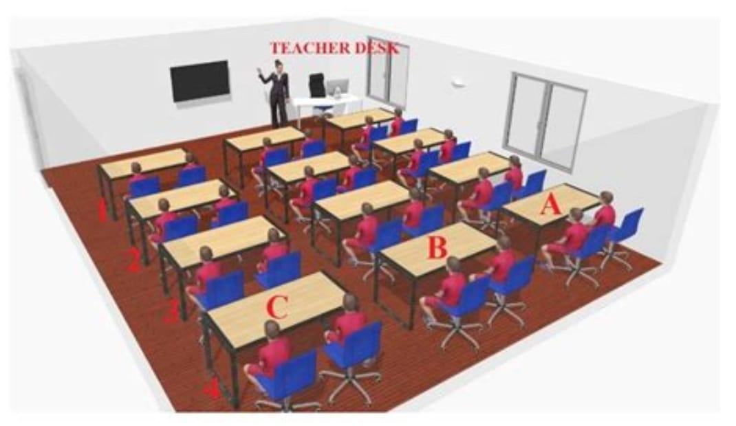
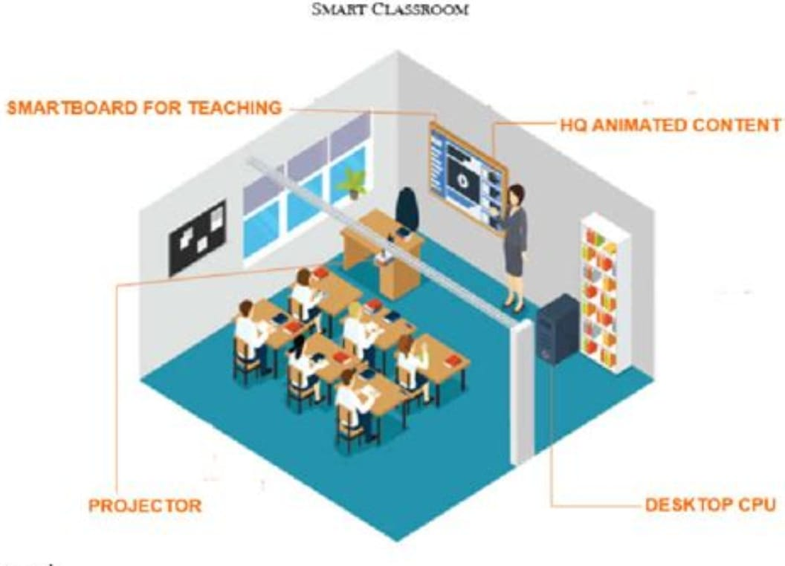
Existing Methods
1.Automated Attendance Systems:
By deploying cameras within the classroom,
computer vision algorithms can perform facial
recognition to identify and record student
attendance automatically. This method reduces
manual effort and increases accuracy.
2.Environmental Control:
IOT devices equipped with sensors monitor
environmental parameters such as temperature,
humidity, and lighting.
3.Security Monitoring:
Integrating OpenCV with IoT devices enhances
classroom security.

Slide 11
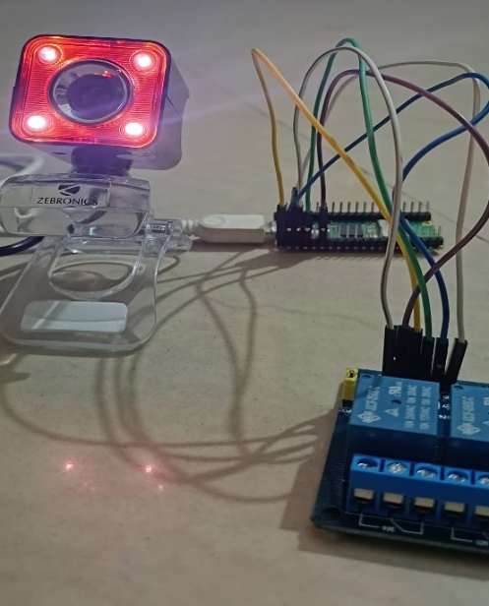
Proposed Solutions
1.Automated strength detection using computer vision:
Cameras capture images of students.
CV Process:
Use open cv for face detection.
Count the num of students by identifying faces.
2.Environmental monitoring and control :
Combining iot with open cv based occupancy
detection
CV Process:
Detect the num of persons in the class
Identify the zone of the students.
Automatically fans turn on/off with the zone

Slide 12
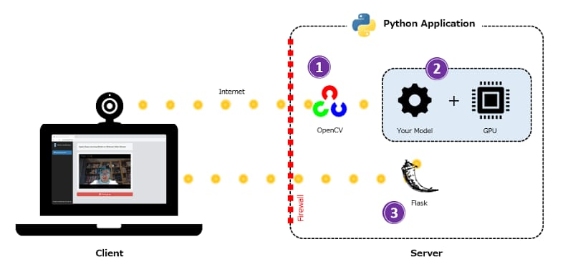
Sofrware Requirements
Python (for OpenCV programming ,flask and mediapipe)
Flask is a lightweight Python web framework that helps developers build web applications.
Open CV in Python is an open-source library that provides tools for computer vision, image processing, and machine learning.

Slide 13
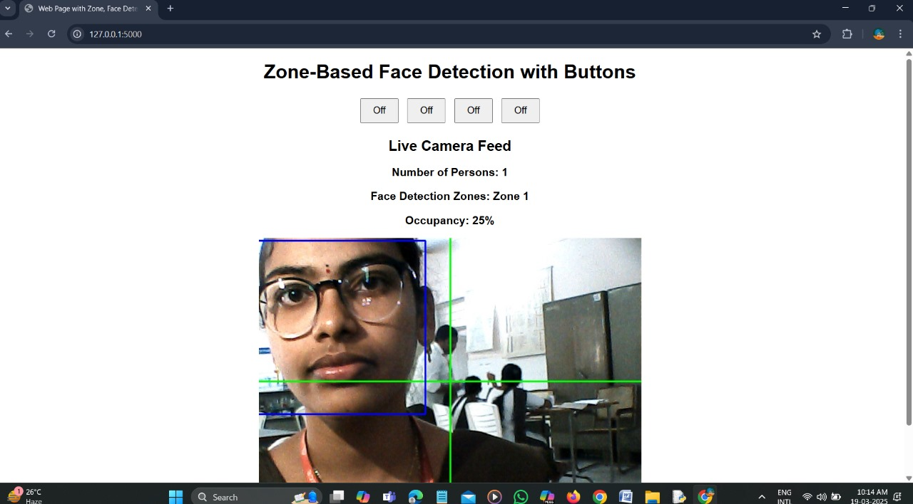
Result and analysis
1. Face Detection and Student Tracking
The system successfully detects and tracks the number of students in real-time using computer vision and face detection algorithms.

Slide 14
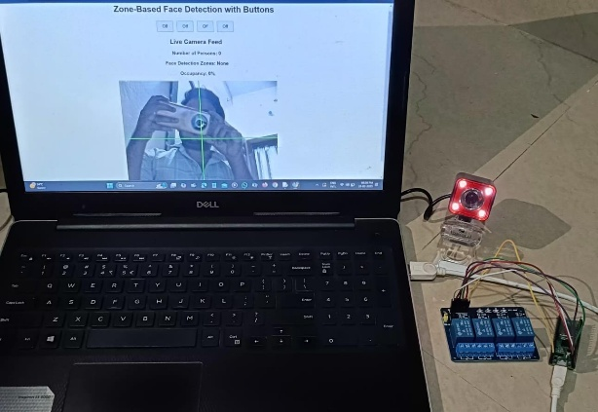
2. Zone based devices controlled by IOT
The classroom was divided into distinct zones where IoT-enabled electrical devices were activated based on student presence. Observations include:
Devices were automatically turned ON within 1-2 seconds of detecting student presence and turned OFF when the zone was vacated.
Energy consumption analysis indicated a reduction of up to 30-40% compared to traditional always-on systems, contributing to increased energy efficiency.

Slide 15
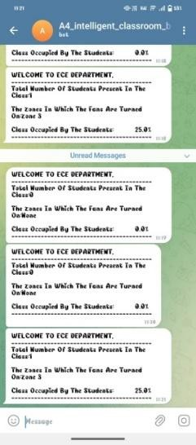
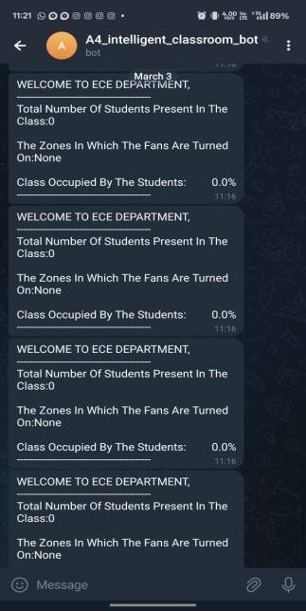
3. Telegram bot notifications
Real-time notifications were sent through a Telegram bot to update users on classroom activity and energy efficiency efforts.

Slide 16
References
K. Atukorala, D. Wijekoon, M. Tharugasini, I. Perera, and C. Silva, “SmartEye - Integrated solution to automation, security and monitoring through mobile phones,” NGMAST 2009 - 3rd Int. Conf. Next Gener. Mob. Appl. Serv. Technol., no. May 2016, pp. 64–69, 2009.
P. S. Nagendra Reddy, K. T. Kumar Reddy, P. A. Kumar Reddy, G. N. KodandaRamaiah, and S. N. Kishor, “An IoT based automation using android application,” 2016 Int. Conf. Signal Process. Commun. Power Embed. Syst., pp. 285–290, 2016.
K. Puthea, R. Hartanto, and R. Hidayat, “A Review on Attendance Marking System based on Face Recognition,” 2017 2nd Int. Conf. on Information Technology, Information . Syst and Elect Eng., pp. 303–308, 2017.
G. Sfikas, “Creating a Smart Room using an IoT approach,” ResearchGate, no. May, 2016.
J. Lohokare, R. Dani, A. Rajurkar and A. Apte, "An IoT ecosystem for the implementation of scalable wireless automation systems at smart city level," TENCON 2017 - 2017 IEEE Region10 Conference, Penang, 2017, pp. 1503-1508

Slide 17
Any Questions ?

Slide 18


